Slide 1
Data Governance Academy
Prep Meeting – Hosting County Offices of Education
August 2025

Slide 2

Agenda
Prior to the Session
Marketing
Registration
Day-Of Considerations
Logistics
Content
Session Overview
Post-Session Considerations
Surveys
Successive Sessions

Slide 3
Prior to the Sessions

Slide 4
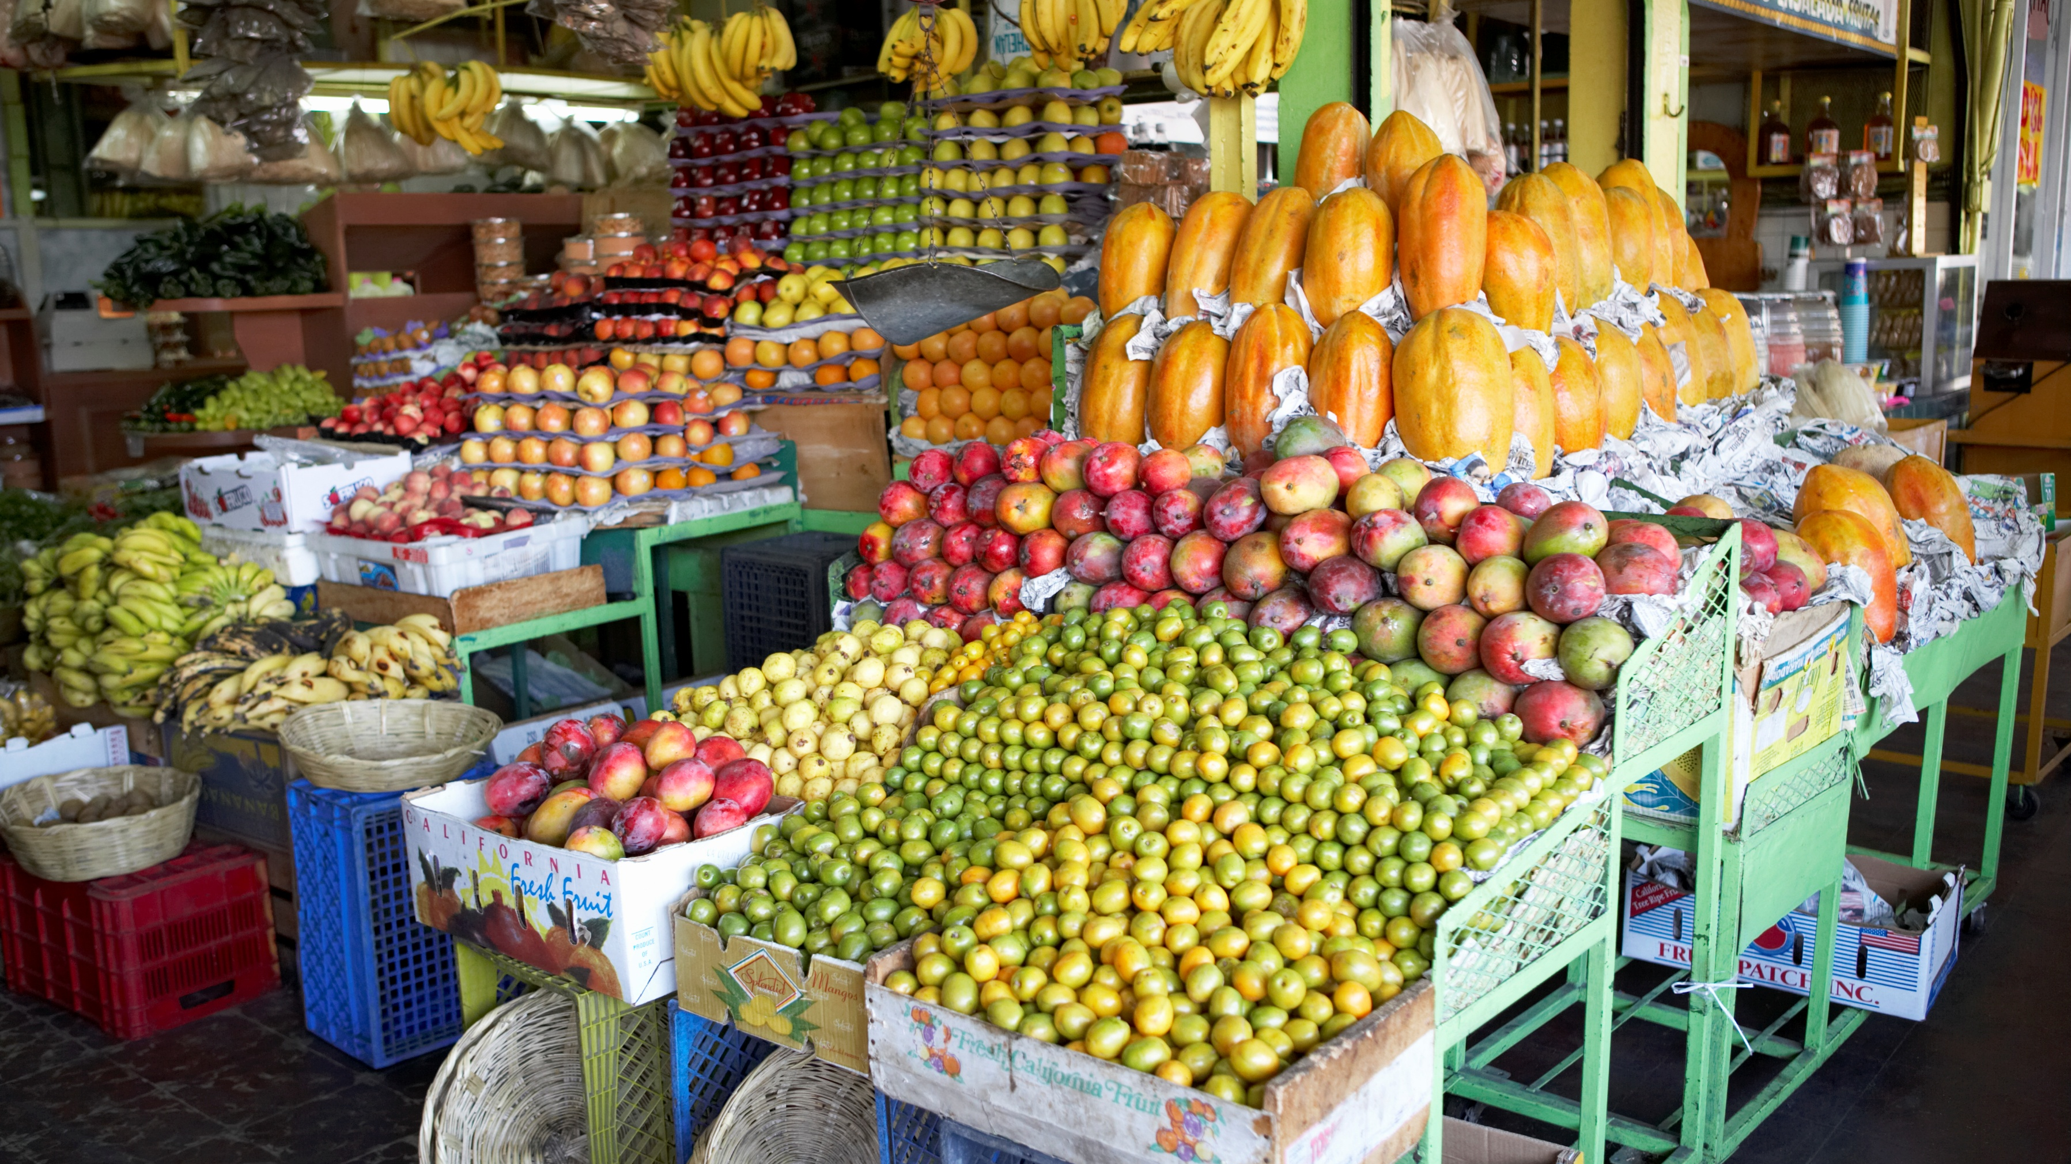
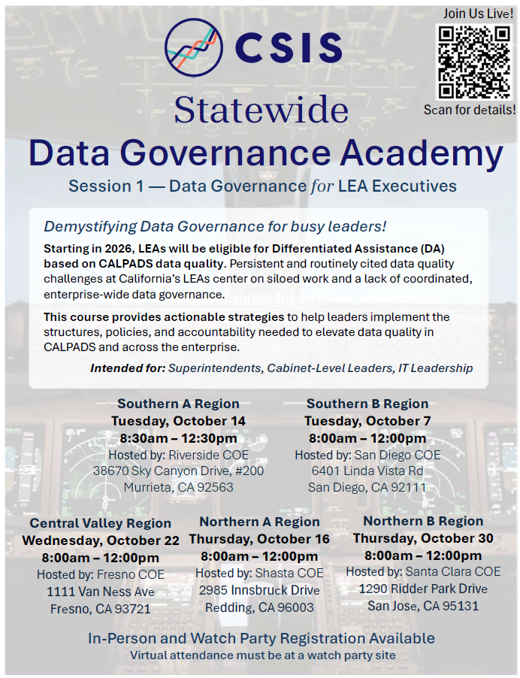
Marketing
Flyers distributed regionally through hosting COEs
California County Superintendents (CCS) – BASC, TSC, CISC
California IT in Education (CITE)
California Educational Research Association (CERA)

Slide 5

Three Registration Options
In-Person
Watch Party Site
  Facilitator Meeting in September
Watch Party Participant

Slide 6
Day-of Considerations

Slide 7

Logistics
100 Seats
Table Groups (6-12)
Mic & Camera (Zoom-ready Room)
  CSIS Laptop w/Presentation
Sign-In Sheets
  In-Person
  Watch Parties

Slide 8

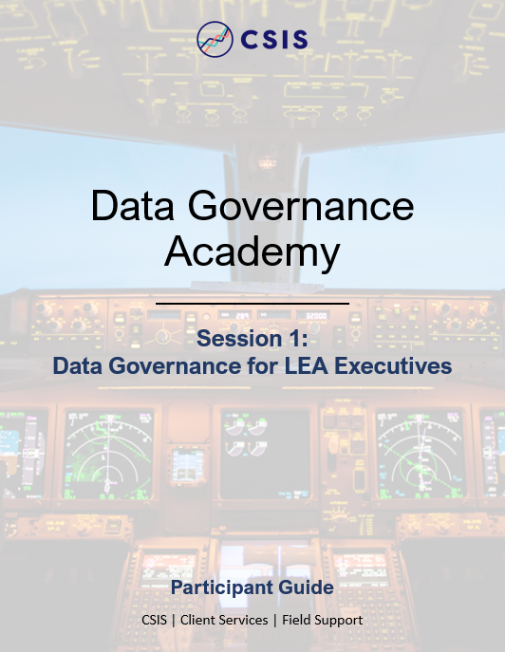
Content
Participant Guides (printed)
LEA Showcase Video Media
Q&A Spreadsheet – MS Forms
Activities Facilitation

Slide 9

Session 1 – Data Governance for LEA Executives
Objectives
Assist COEs providing DA support
Demystify Data Governance
Establish Foundational Structures
Align data work with strategic goals
Foster a Culture of Data Stewardship
Topics
Data Governance Overview
Roles & Responsibilities
Policies & Procedures
Accountability & Audits
LEA Showcase
Q&A

Slide 10
Post-Session Considerations

Slide 11

Surveys
Microsoft Forms
Open October 1 - November 7
QR Code and Link provided in session
Content, Cadence, Format, Instructor feedback desired

Slide 12

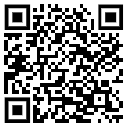

Half-day sessions
Data Governance Academy
Session 1: Data Governance for LEA Executives
October 2025
Virtual Check-In: Case Study and Project Progress
February 2026
Session 2: Operationalizing Data Governance at Scale
April 2026
In-Person and Watch Party Registration Available
https://csis.fcmat.org/data-management/csis-data-governance-academy

Slide 13
Q&A

Slide 14
Thank You!
Matthew Clark
CSIS Data Governance Administrator
mclark@fcmat.org
(916) 325-9213
Rob Canales
CSIS Implementation Specialist
rcanales@fcmat.org
(916) 325-9218

